Slide 1
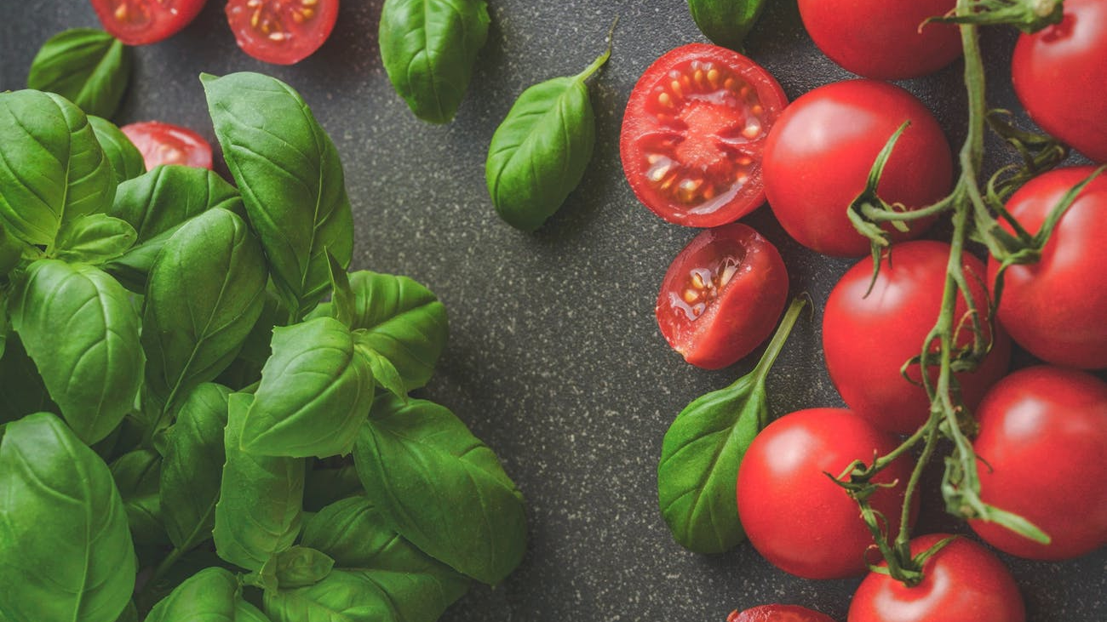
eatUP
Mani, Brad, Daniel, Shing & Marie.

Slide 2
AGENDA
OVERALL CONCEPT OF OUR APPLICATION
MOTIVATION FOR DEVELOPING THIS APP
OUR DESIGN PROCESS
TECHNOLOGIES USED
DEMO OF APP’S FUNCTIONS
DIRECTION FOR FUTURE DEVELOPMENT

Slide 3
OVERALL CONCEPT OF OUR APPLICATION
eatUP is designed to help any user figure out what they want to eat in a matter of seconds.
The app provides different recipes and the user can pick which one they desire the most.
We also provide a nutritional table that can be beneficial to the user.

Slide 4
MOTIVATION FOR DEVELOPING THIS APP
We’ve all experienced the same thing, with the question of “What should we eat?” and usually stumped for answers.
So we wanted to make it easier for any user to pick their preferred meal without having to spend a lot of time scrolling through google to figure it out.

Slide 5
OUR DESIGN PROCESS
Choosing the recipe option.
4 different recipes will be shown.
Once the user has picked a recipe, 3 new choices will show up.
Whatever the user decides as their final decision, this will be shown at the end, with the recipes nutritional info with the click of a button.
The user can decide whether they want to start over or go with their preferred choice.

Slide 6
TECHNOLOGIES USED
HTML
CSS
JAVA
JQuery
AJAX
Bootstrap
Google Fonts

Slide 7


API’S USED
We used the Food2Fork for recipes…
Edamam for the nutritional information.

Slide 8
PROBLEMS WE FACED.
Restaurant API Zomato wasn’t working.
Time constraints.
Cost Restraints.
Front End/Back End code clashes.
Inexperience with Github – push and pull.

Slide 9
DIRECTION FOR FUTURE DEVELOPMENT
Making a restaurant locater.

Slide 10
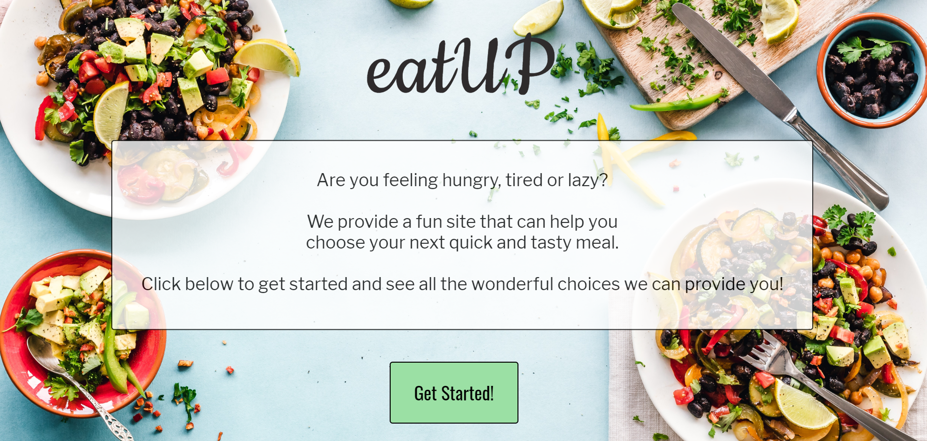
DEMO OF APP’S FUNCTIONS
https://daniel-brewer-stephenson.github.io/project1/

Slide 11
Any Questions?
Please ask after class, thx ☺

